Slide 1
SUPERVISED LEARNING

Slide 2
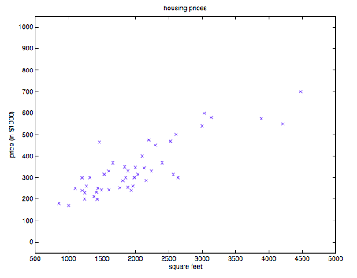
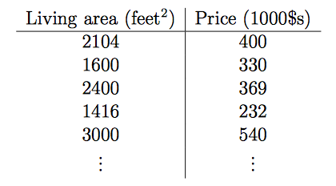
Supervised Learning
Example: Given a dataset of living areas and prices of houses in a given area.
How can we learn to predict the prices of other houses in that same area, as a function of the size of the living area.
i.e. Can we learn a function h, such that h(x) is a good predictor for the corresponding value of y.
“input” variables
or features => x^{(i)}
“output” variables or target => y^{(i)}

Slide 3
Supervised Learning
Training Set
Learning Algorithm
Function
h
x
Predicted y
When trying to predict a continuous variable, that’s called a regression problem.
When trying to predict only small number of discrete values, we call it a classification problem.

Slide 4
Outline
Regression
Linear regression
Classification
Logistic Regression

Slide 5
Linear Regression
Problem: Need to find a function h, that approximates the target variable y as a linear function of the features x_{i} .
h(x) = θ₀ + θ₁x₁ + θ₂x₂
Assume training data has two features x₁ and x₂ (or input variables).
The θ_{i} are the parameters (or weights) of the linear function.
Idea: choose θ_{0,} θ₁, and θ₂ so that h(x) is close to y for our training examples

Slide 6
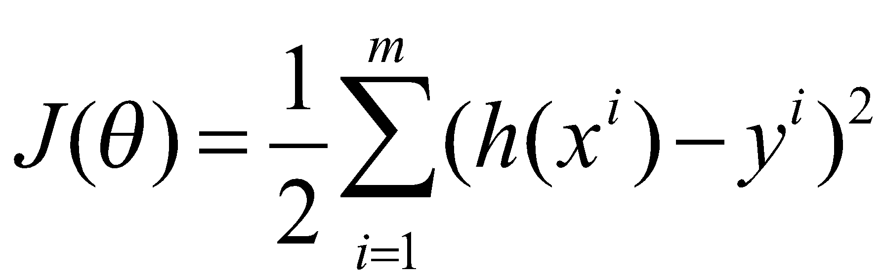
Objective Function for Linear Regression
Problem: Need to find a function h, that approximates the target variable y as a linear function of the features x_{i} .
h(x) = θ₀ + θ₁x₁ + θ₂x₂
So, given the training data, how to pick the parameters θ_{i ?}
Choose θ_{i} such that h(x) closely approximates y. i.e. choose θ_{i} that minimize the cost function.
m – number of training samples
J(θ) is called squared error cost function

Slide 7
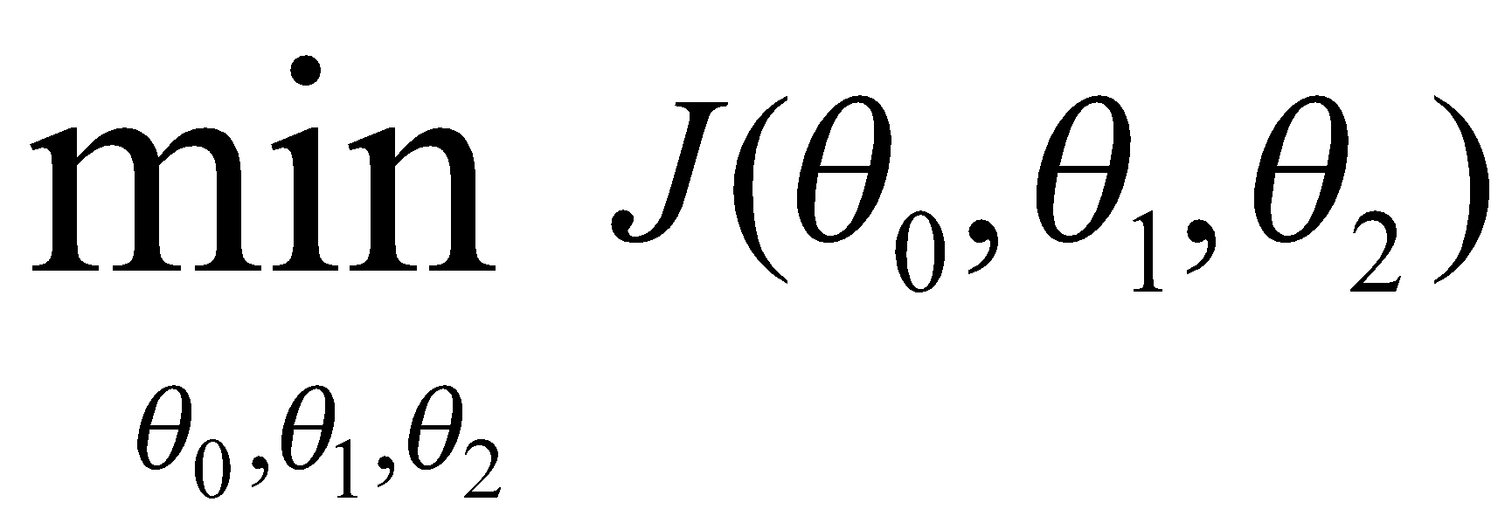
Summary of the problem
Find a function:
h(x) = θ₀ + θ₁x₁ + θ₂x₂
Parameters/Weights: θ_{0 ,} θ_{1,} θ₂
Cost Function:
Goal:

Slide 8
Gradient Descent Algorithm
Idea: We want to choose θ that minimize J(θ), so we can start with an initial guess for θ and repeatedly change θ to make J(θ) smaller until we converge.
We have some function J(θ₀, θ₁) that we want to minimize.
Outline:
Start with some value for θ₀, θ₁
Keep changing θ₀, θ₁ to reduce J(θ₀, θ₁) until we end up at a minimum.
Notes:
We can try to numerically solving the mimumum of the cost function, … normals equation method.
But Gradient Descent scales better for ML applications, and is the method beheind libraries for ML .

Slide 9
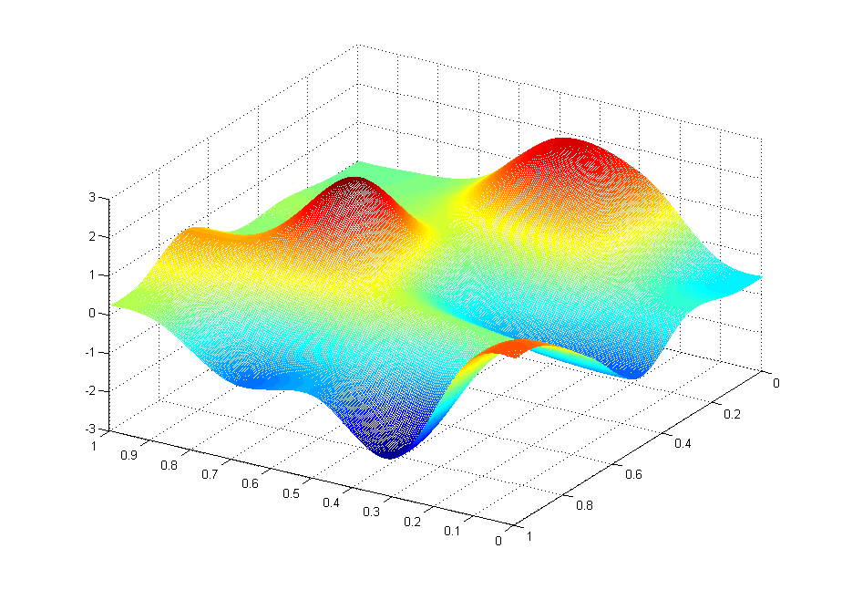
J(θ₀,θ₁)
Cost function
θ₁
θ₀

Slide 10
J(θ₀,θ₁)
θ₁
θ₀

Slide 11
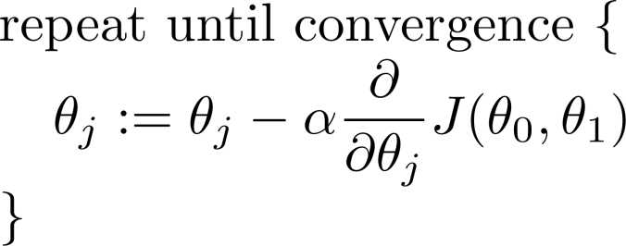
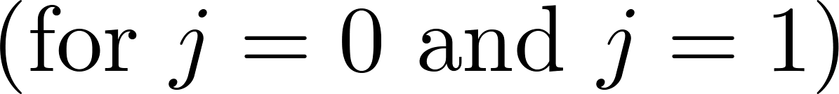
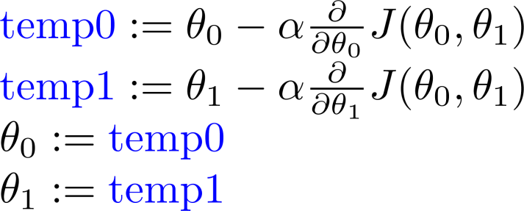
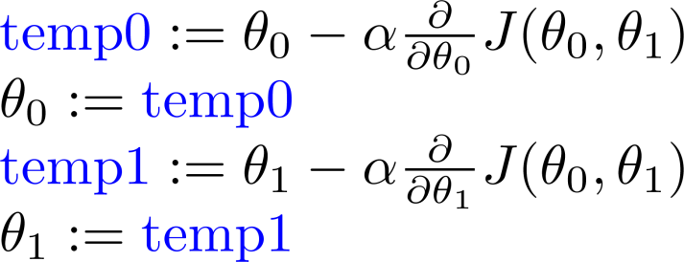
Gradient Descent Algorithm
Learning rate
Correct: Simultaneous update
Incorrect:
Notes:
Each theta is updated by subtracting this term.
learning rate (how large of a step we are taking) the derivative term

Slide 12
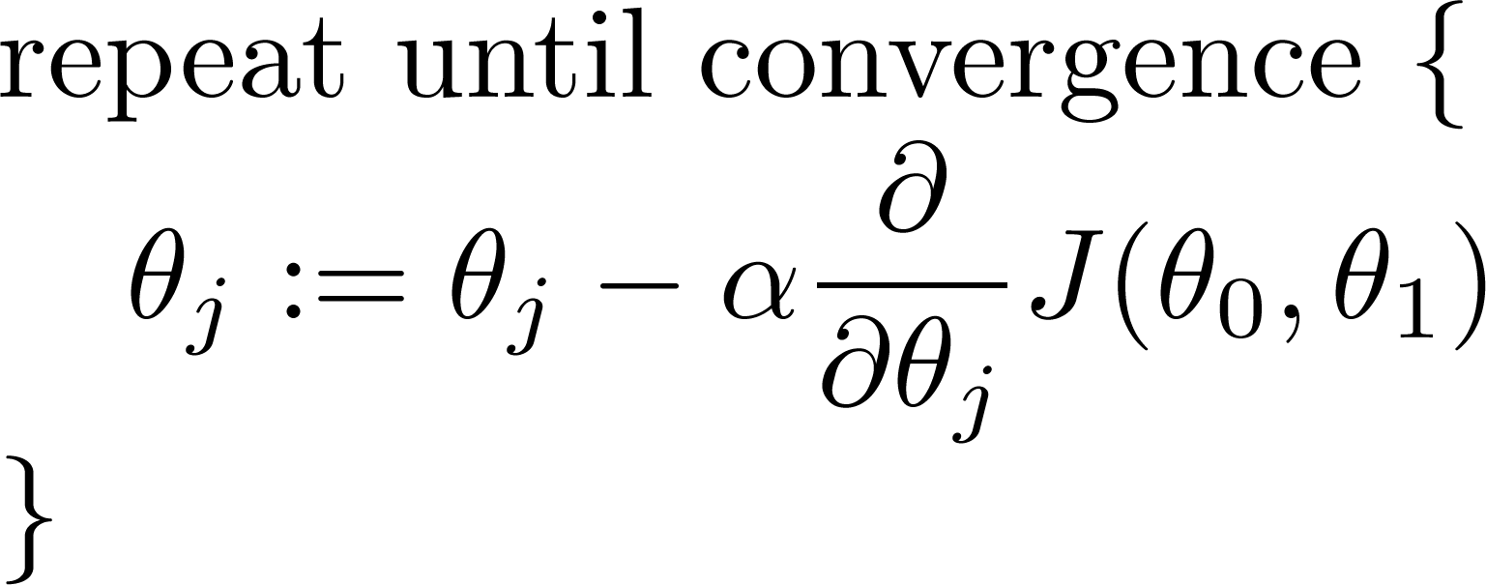
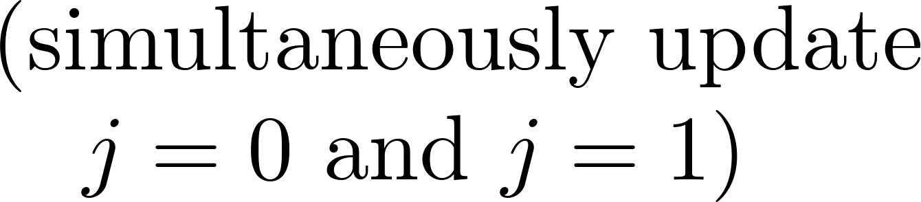
Gradient Descent Algorithm
Learning Rate
How large of a step to take as we update θ_{j}
Derivative

Slide 13
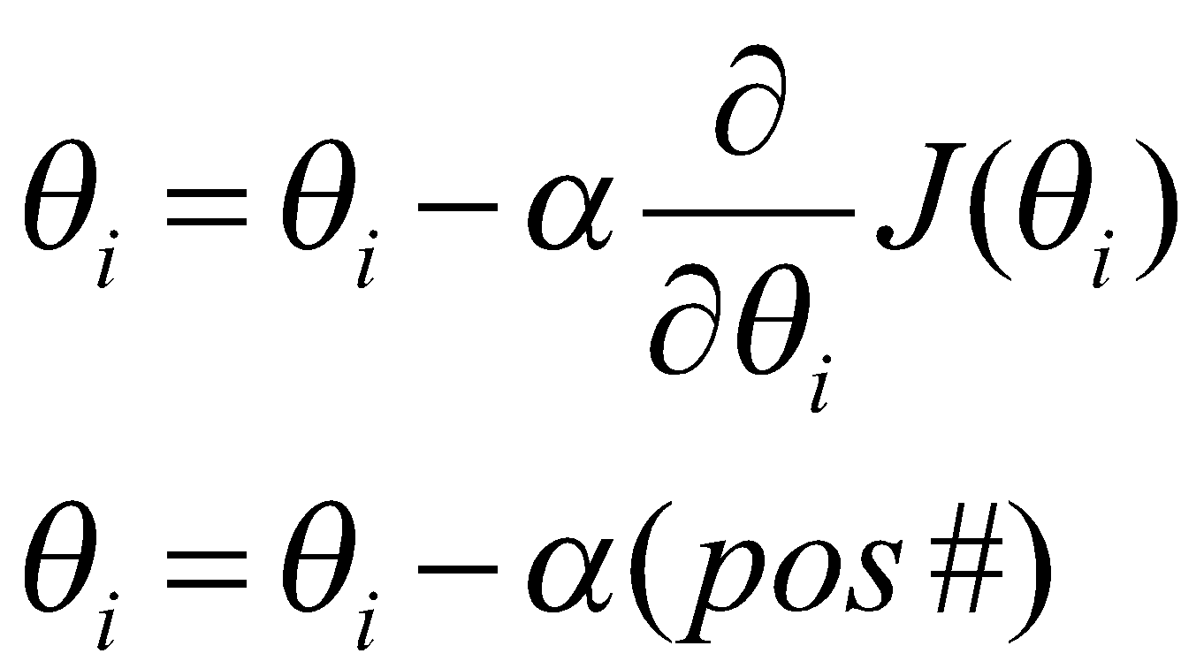
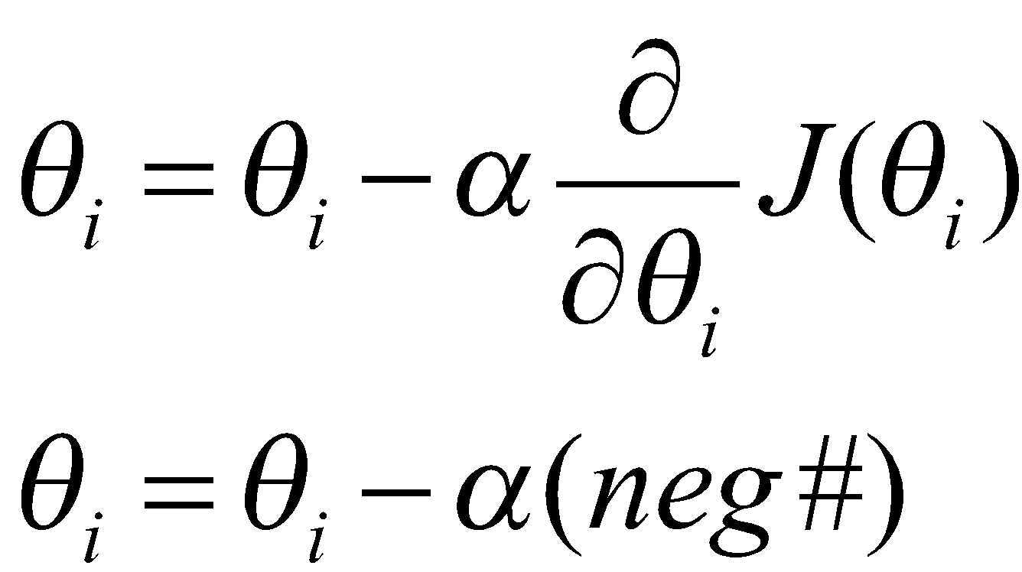
J(θ)
θ
θ
This line has a positive slope
This line has a negative slope
Notes:
The derivative is the slope of the tangent of the function.
The first graph has a postiive slope, so when we are updating theta we will subtract alpha times a positive number… moving to left
The second graph has a negative slope, so when updating theta we will subtract alpha times a negative Number .. Moving thea to the right toward the mimumum.

Slide 14
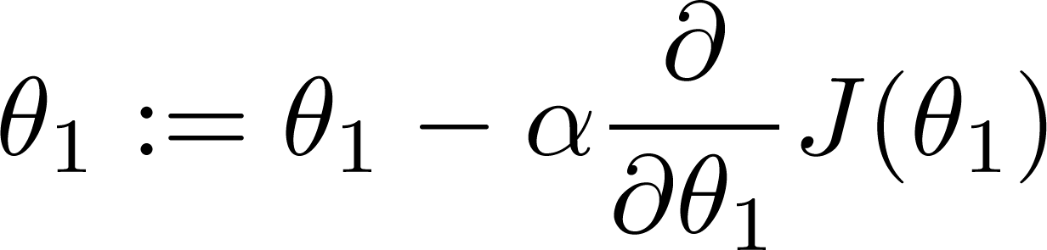

If α is too small, gradient descent can be slow.
If α is too large, gradient descent can overshoot the minimum. It may fail to converge, or even diverge.

Slide 15

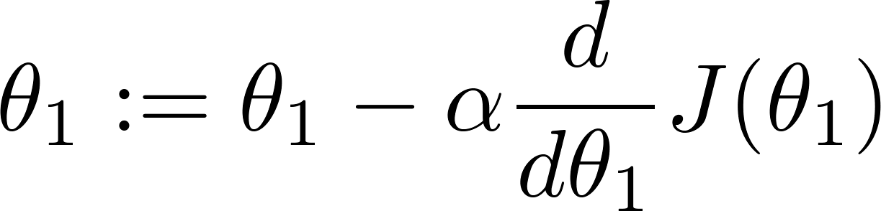
What if you already start at the local minimum?
Slope of gradient
(the derivative) = 0
at local optima
Current value of
= 0
Notes:
What if you already start a local mimimum? Its okay, because the tangent will have a slope of zero… so

Slide 16

Gradient descent can converge to a local minimum, even with the learning rate α fixed.
As we approach a local minimum, gradient descent will automatically take smaller steps. So, no need to decrease α over time.

Slide 17
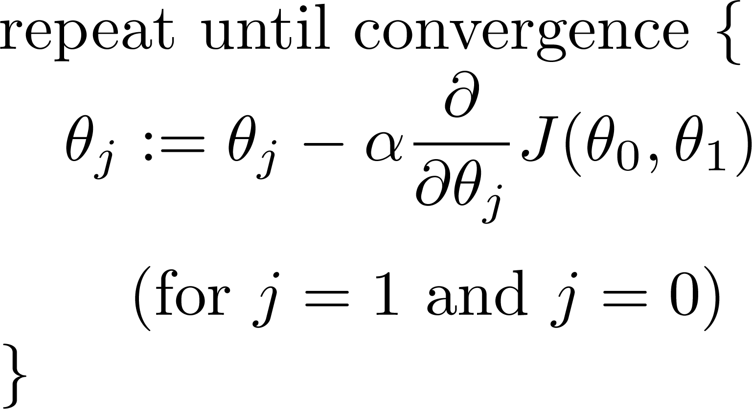
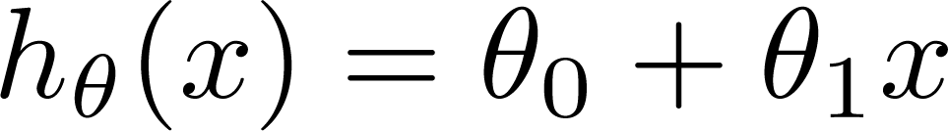
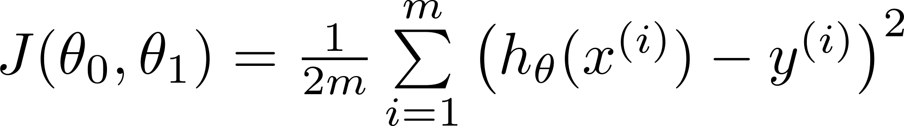
Gradient descent algorithm
Linear Regression Model
Notes:
We just need to apply the GD algorithm to minimize the Linear Regression cost function.

Slide 18
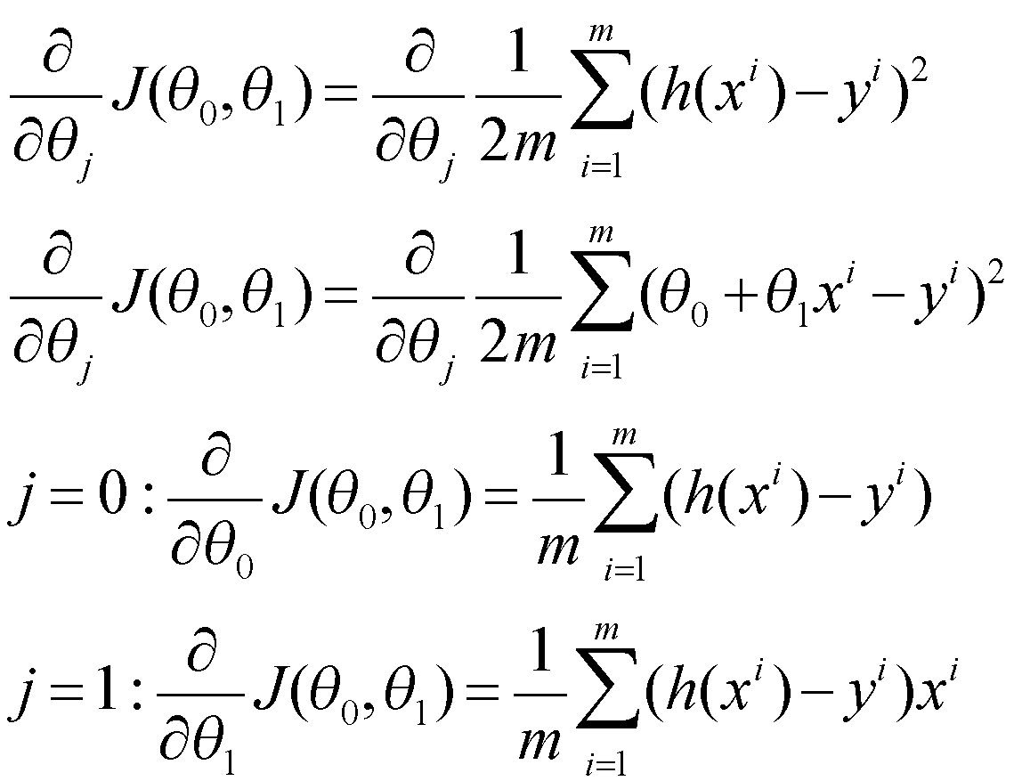
Notes:
We need to figure out what is this derivative term … we simply plug in the Linear Regression cost function for J(thea 0, thea 1).
Then

Slide 19
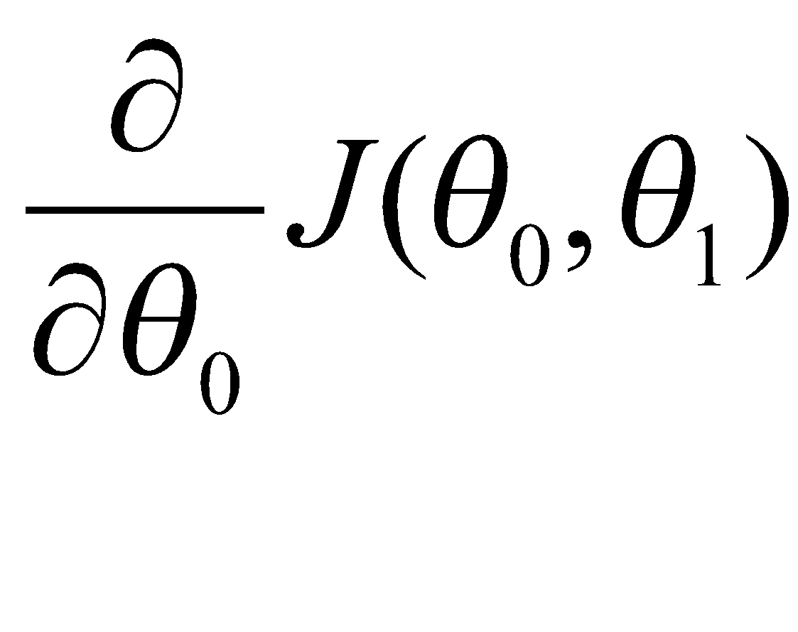
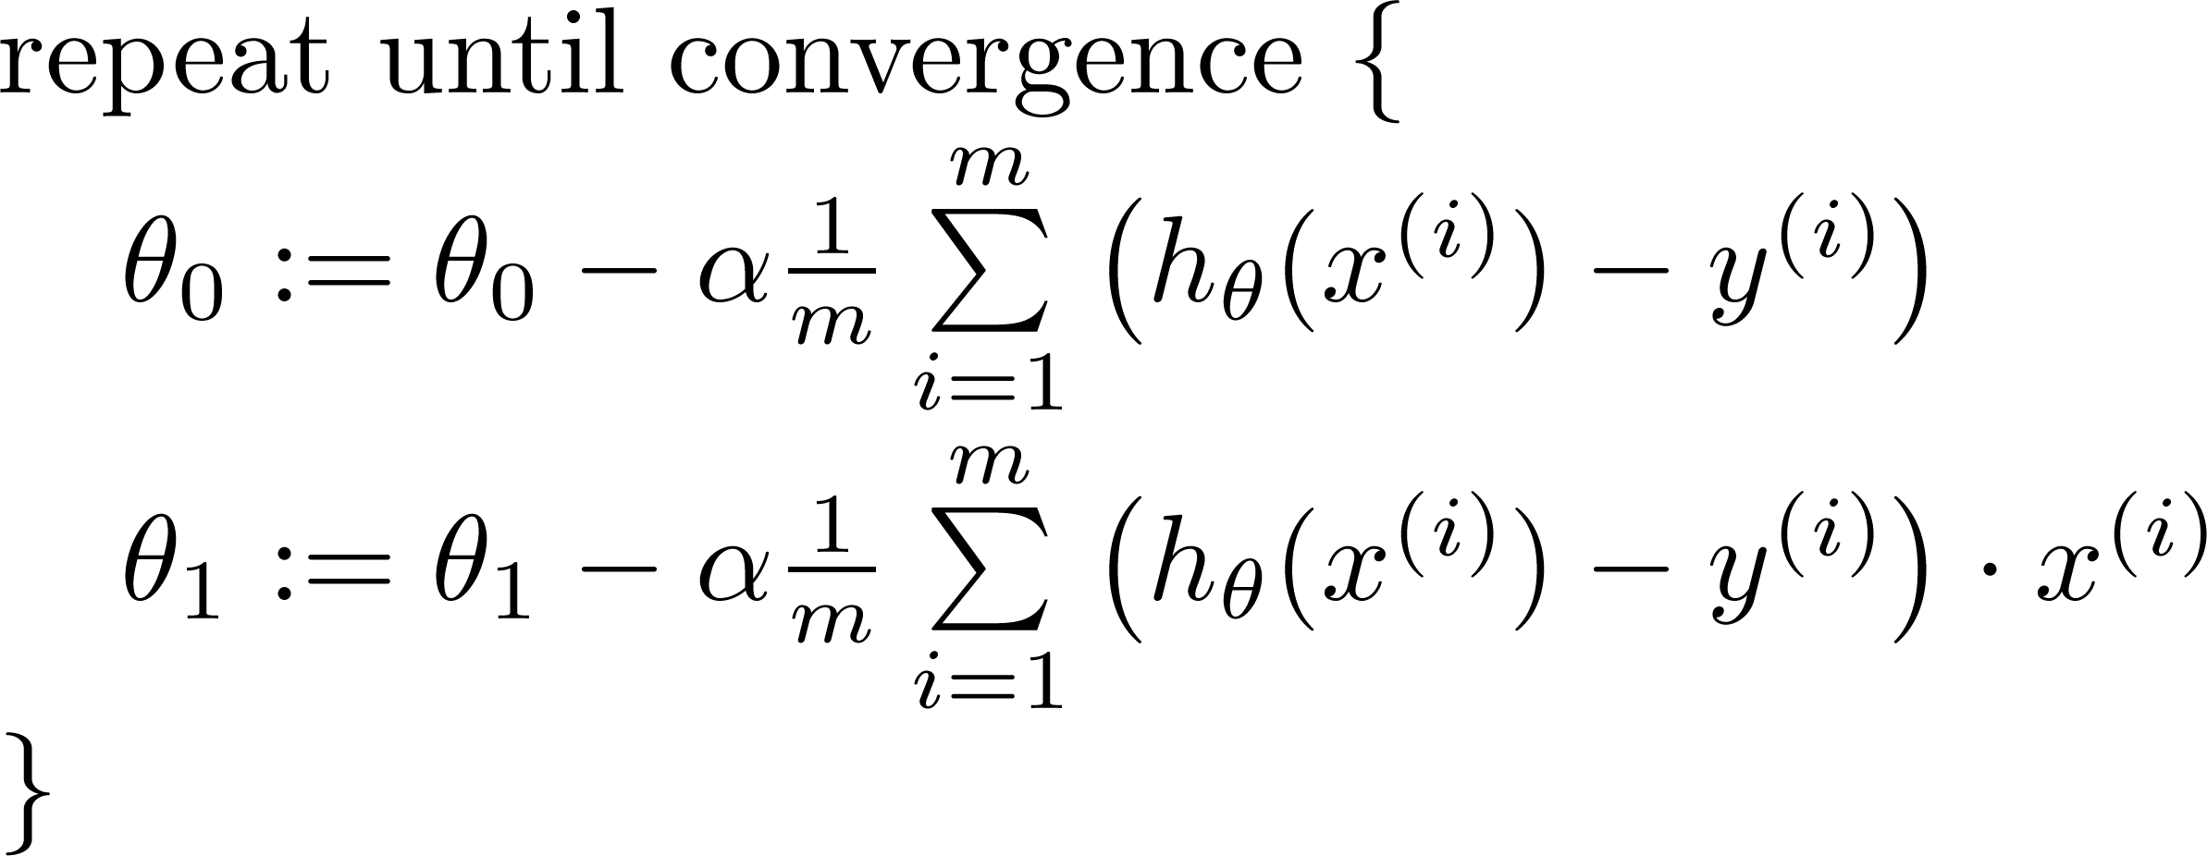

Gradient Descent Algorithm
update
and
simultaneously

Slide 20
J(θ₀,θ₁)
θ₁
θ₀

Slide 21

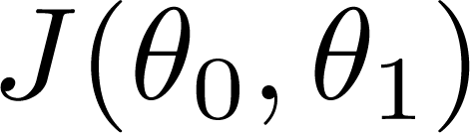


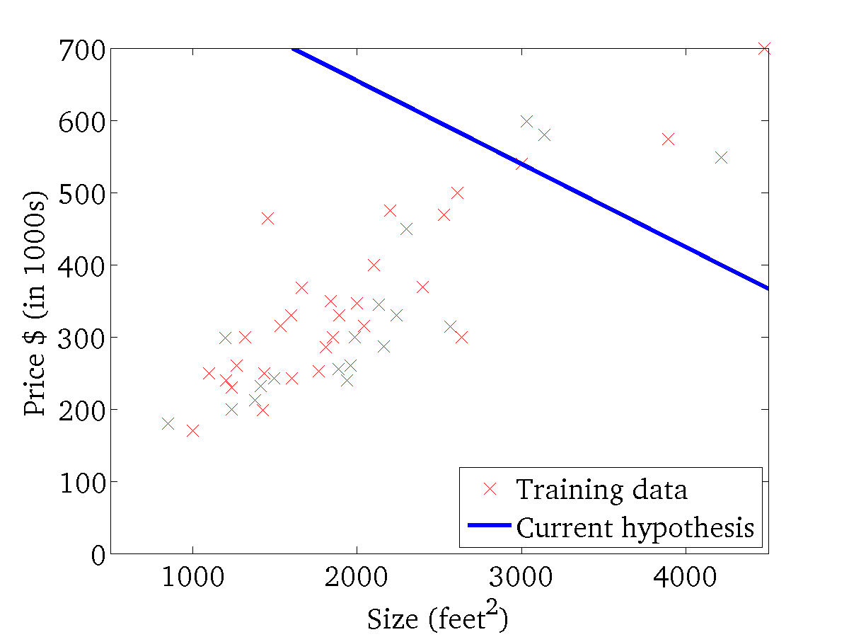
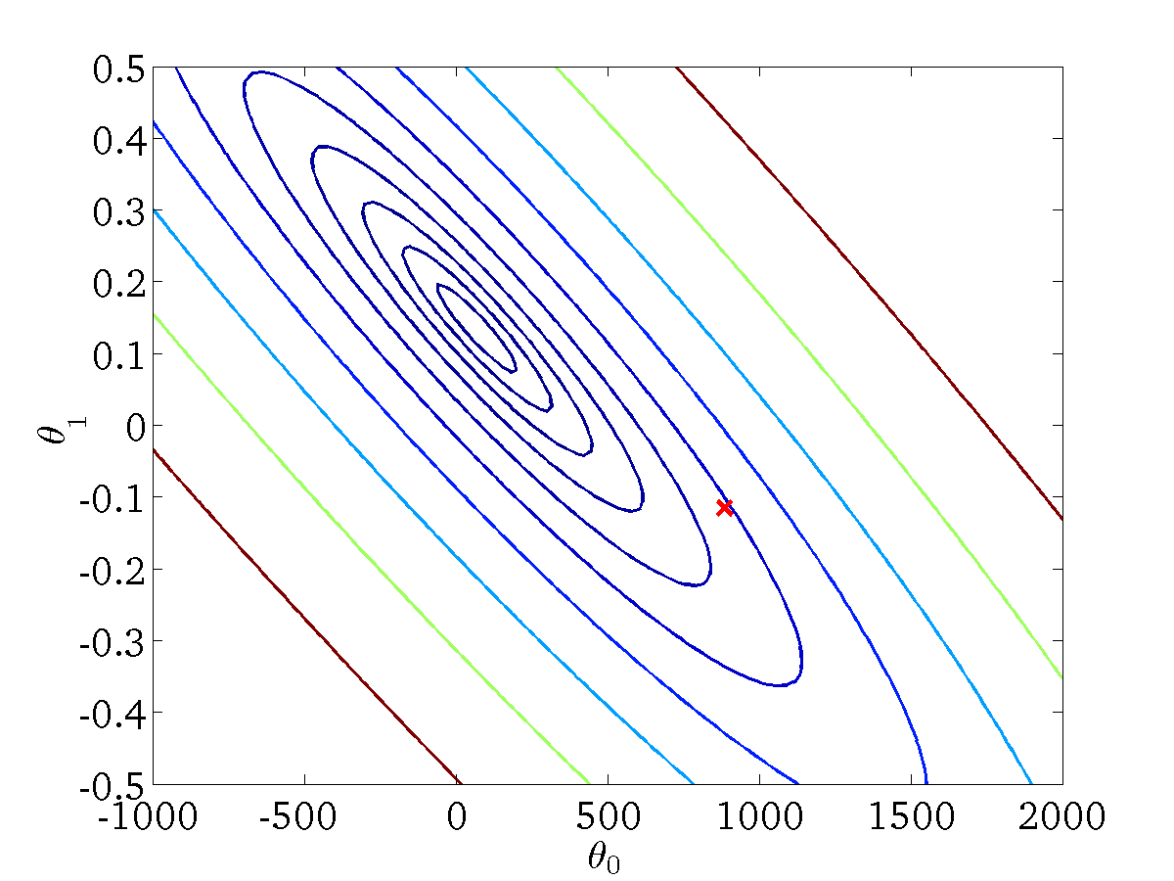
(for fixed , this is a function of x)
(function of the parameters )
Notes:
Thea 0 = 900
Thea 1 = - 0.1

Slide 22
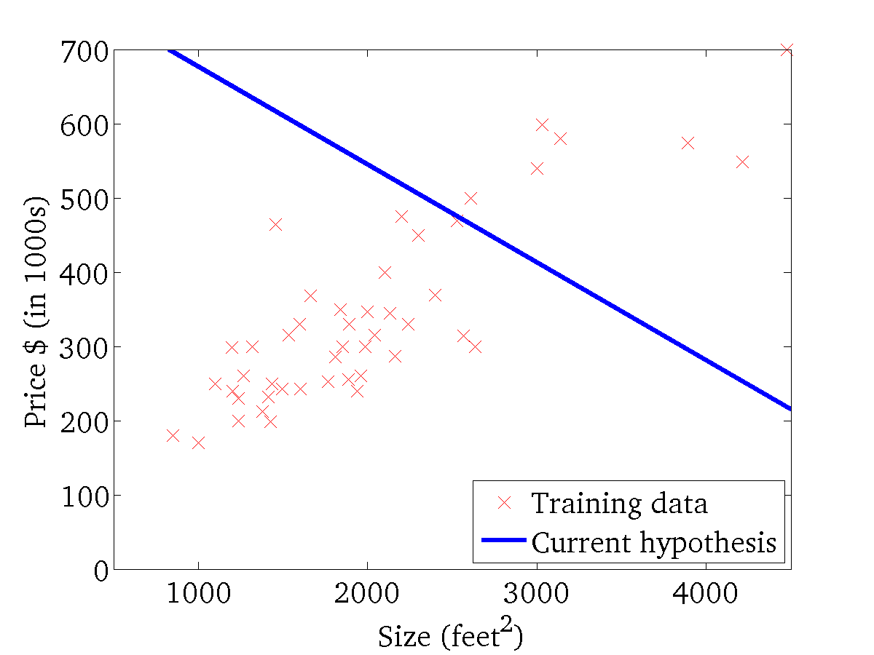

(for fixed , this is a function of x)
(function of the parameters )

Slide 23
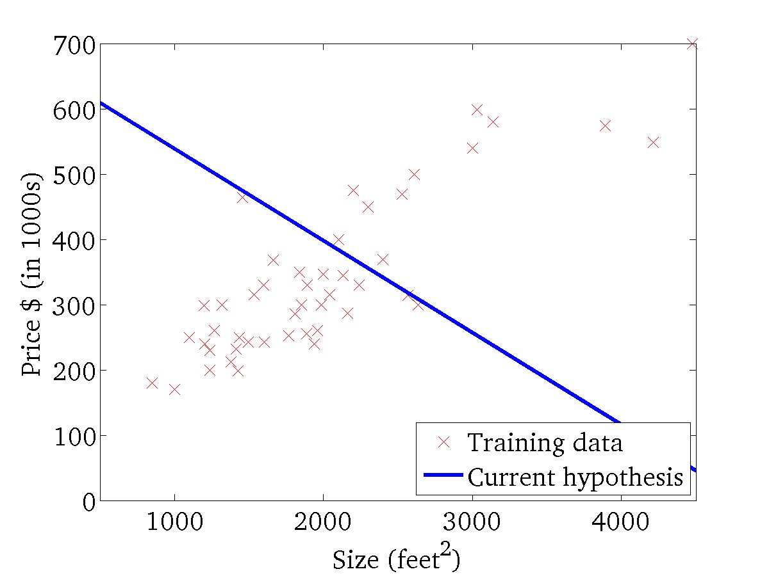
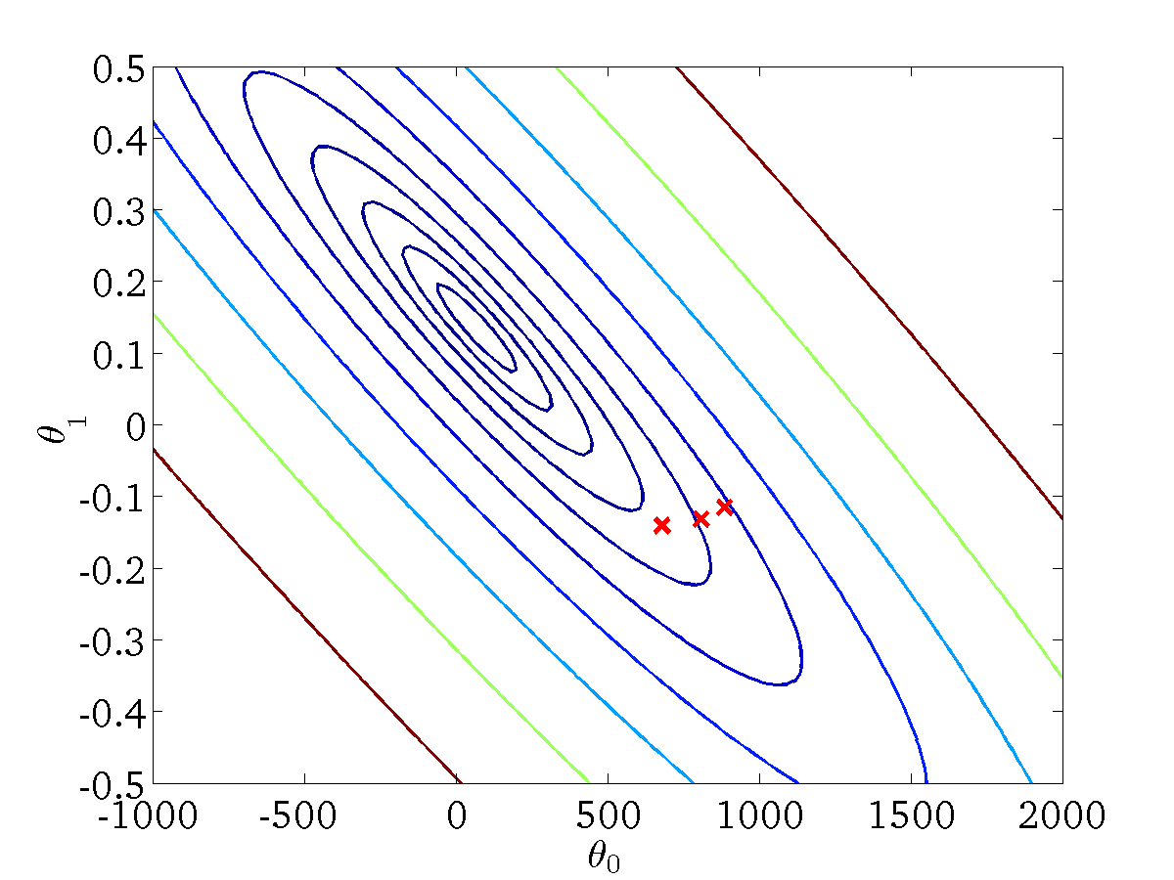
(for fixed , this is a function of x)
(function of the parameters )

Slide 24
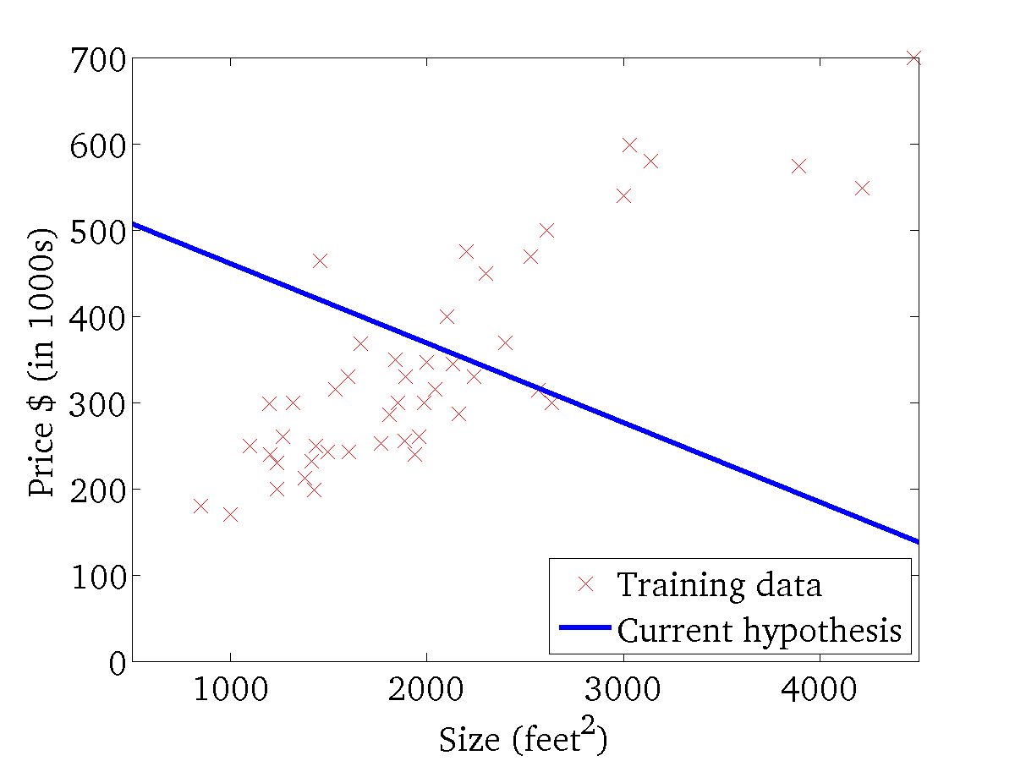

(for fixed , this is a function of x)
(function of the parameters )

Slide 25
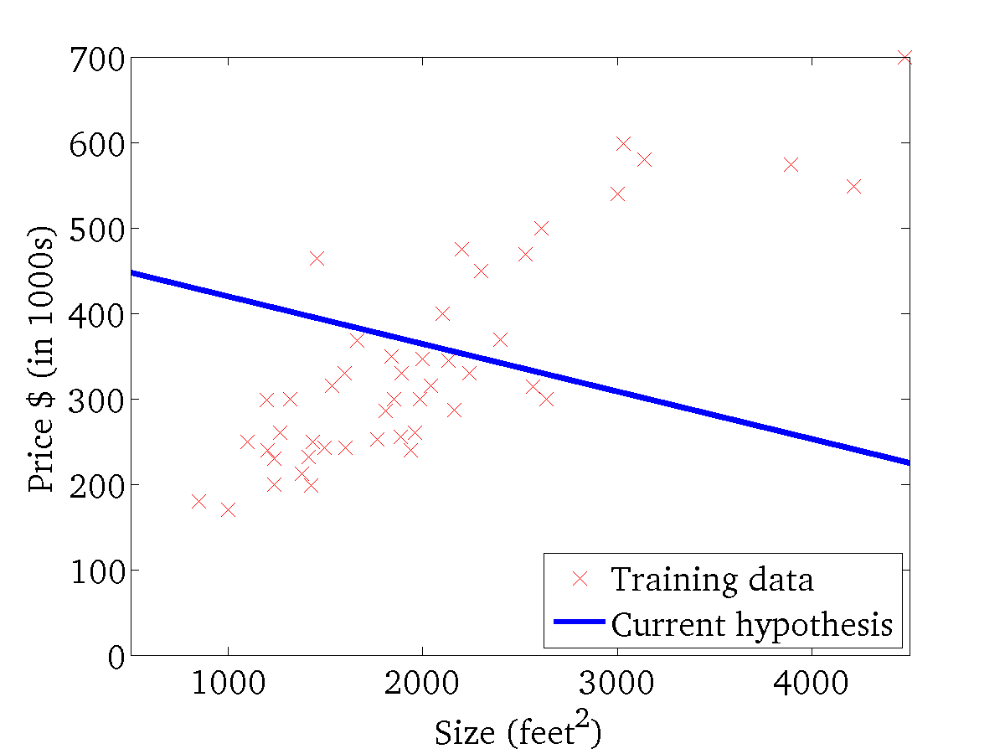
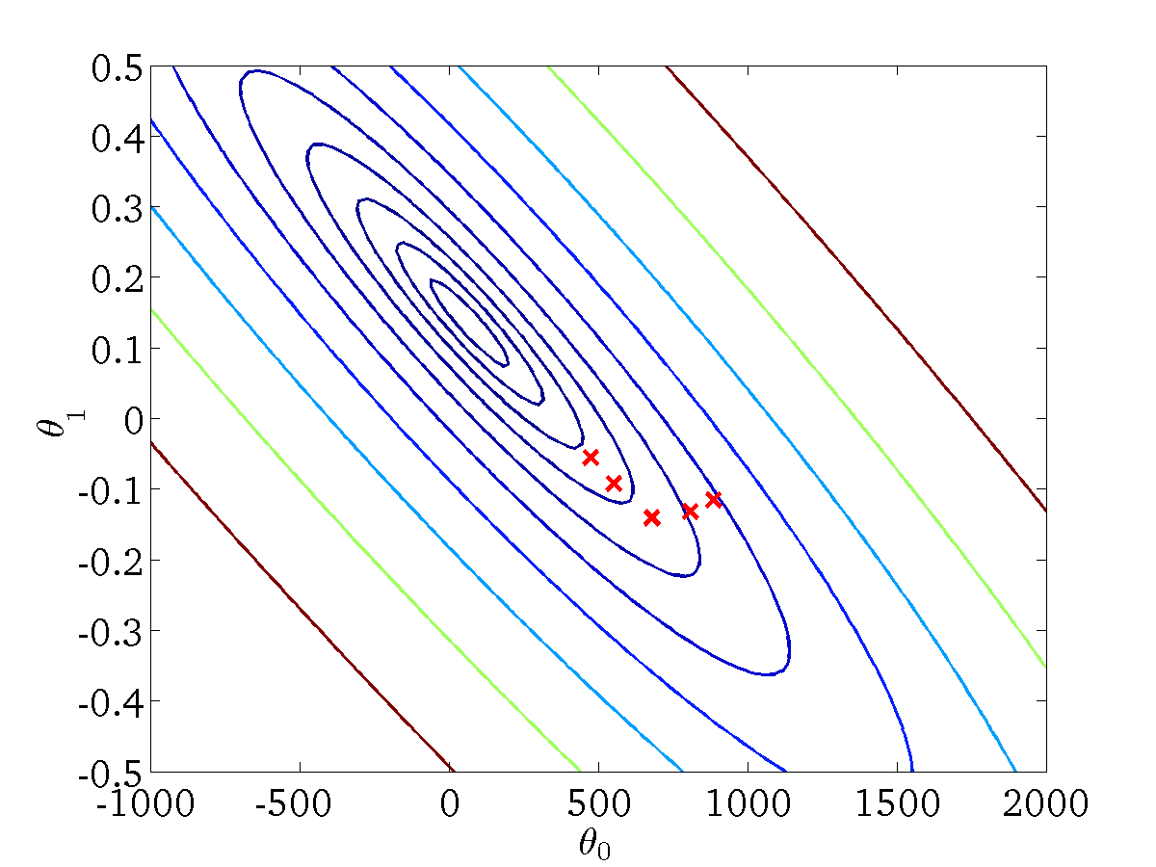
(for fixed , this is a function of x)
(function of the parameters )

Slide 26
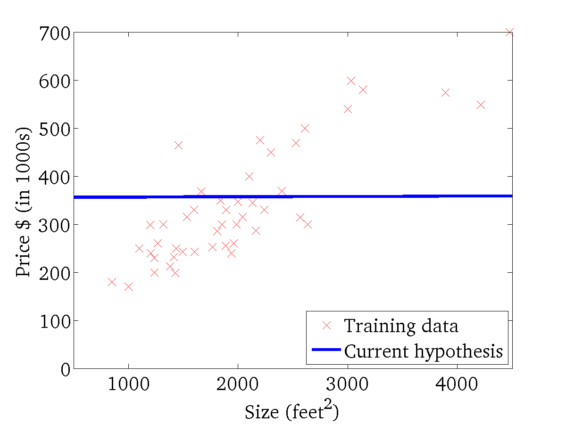

(for fixed , this is a function of x)
(function of the parameters )

Slide 27
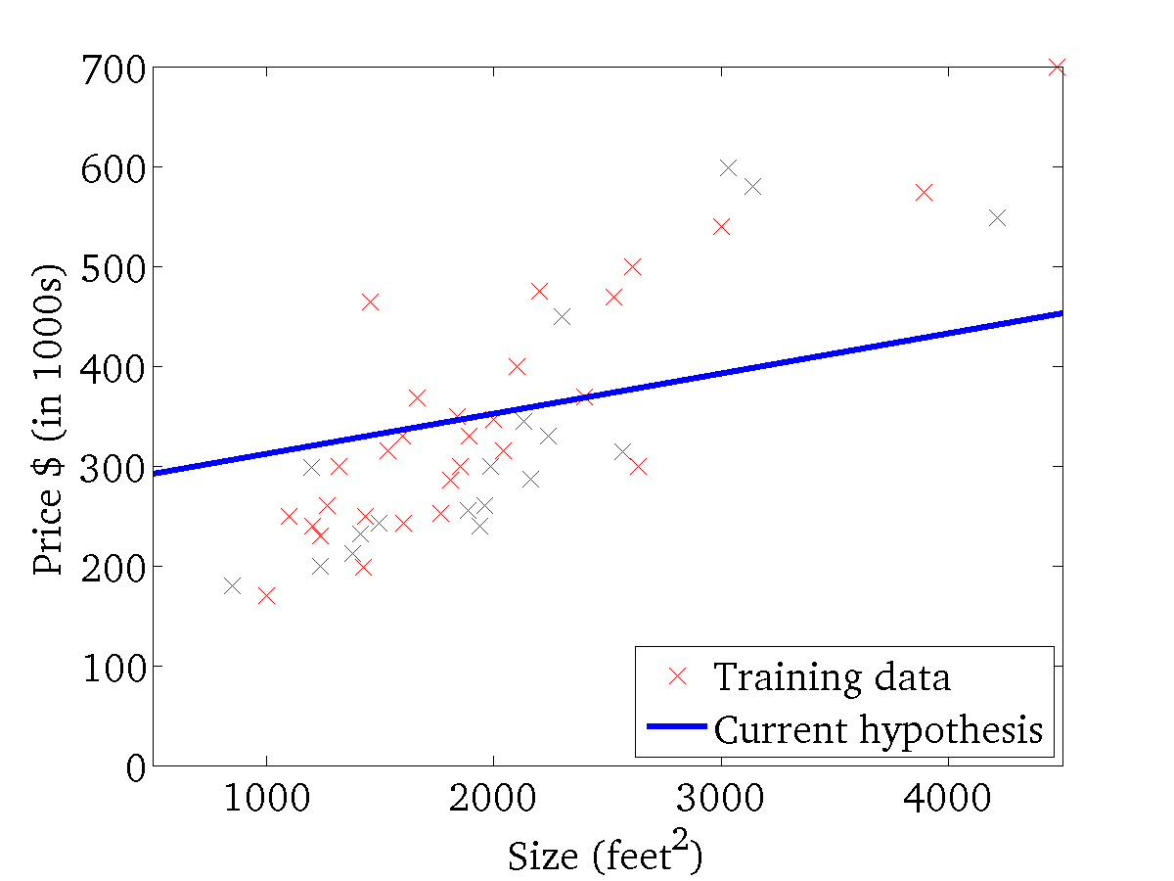

(for fixed , this is a function of x)
(function of the parameters )

Slide 28
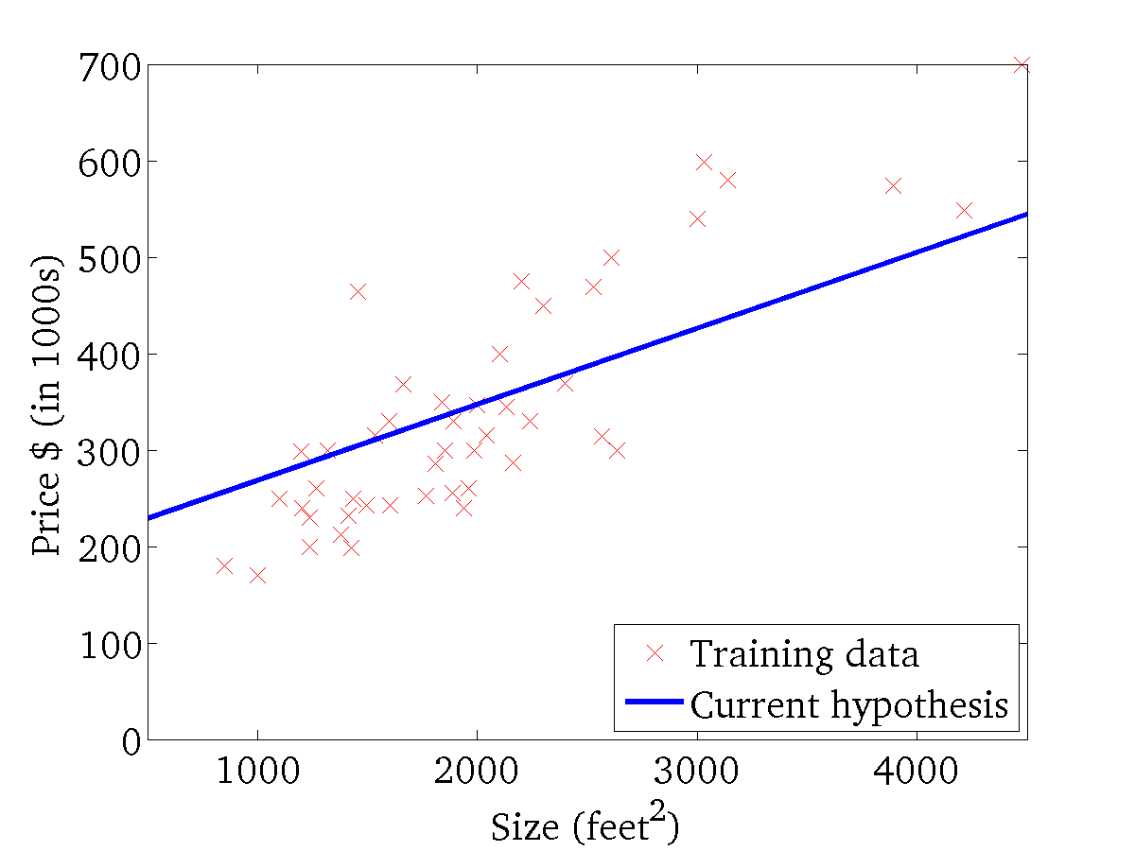
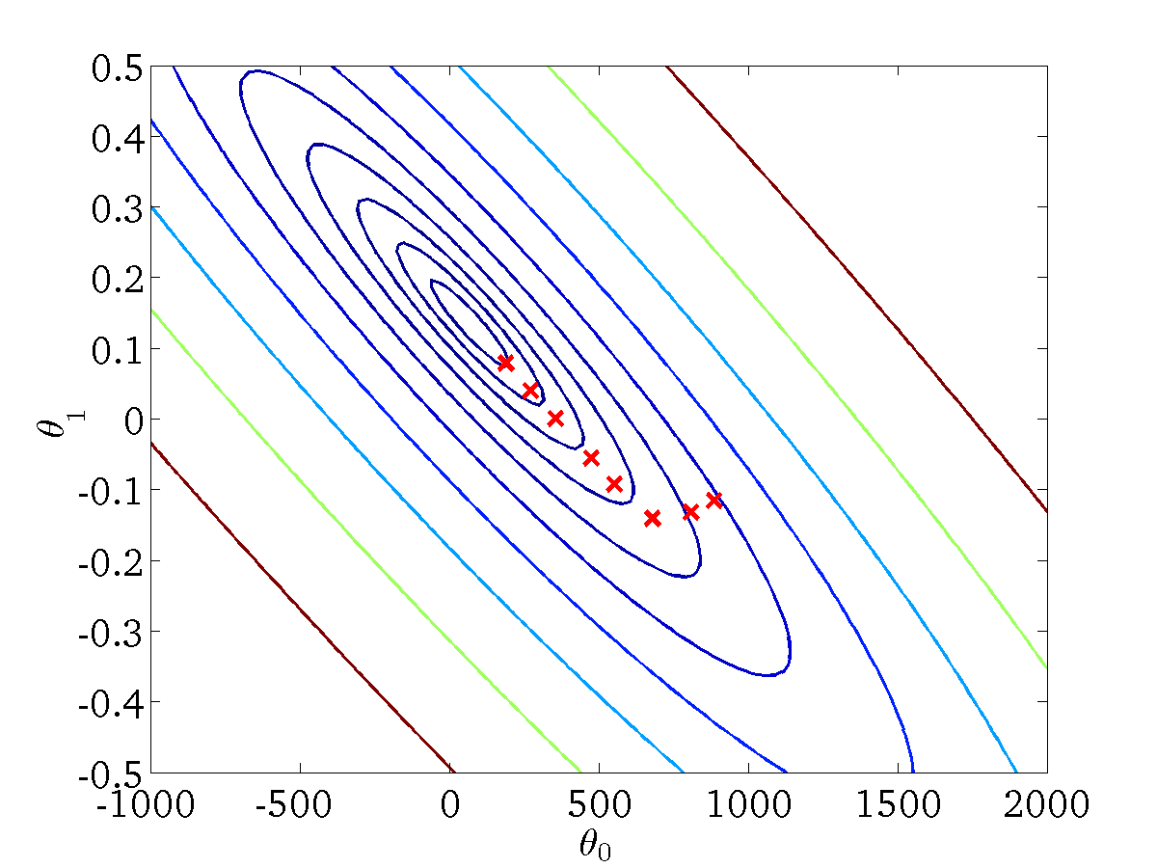
(for fixed , this is a function of x)
(function of the parameters )

Slide 29
Gradient Descent Algorithm
“Batch” Gradient Descent: Each step of gradient descent uses all the training examples.
“Stochastic” Gradient Descent : Each step of gradient descent uses one training example (or a smaller set of training examples). .
Good for large datasets

Slide 30



Single Variable Linear Regression
Size (feet²) | Price ($1000)
2104 | 460
1416 | 232
1534 | 315
852 | 178
… | …

Slide 31
Multiple Variable Linear Regression
Size (feet²) | Number of bedrooms | Number of floors | Age of home (years) | Price ($1000)
2104 | 5 | 1 | 45 | 460
1416 | 3 | 2 | 40 | 232
1534 | 3 | 2 | 30 | 315
852 | 2 | 1 | 36 | 178
… | … | … | … | …

Slide 32
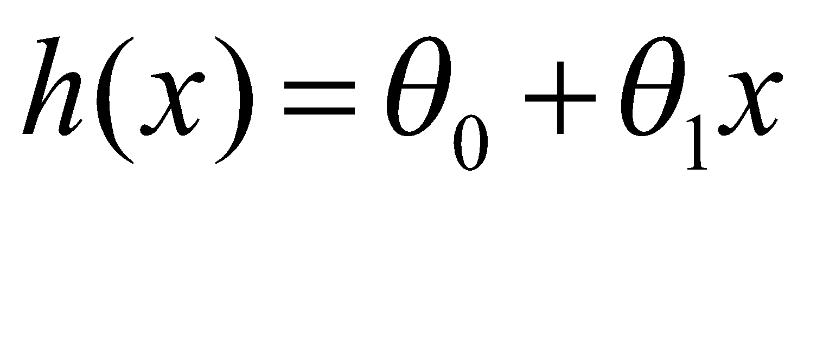
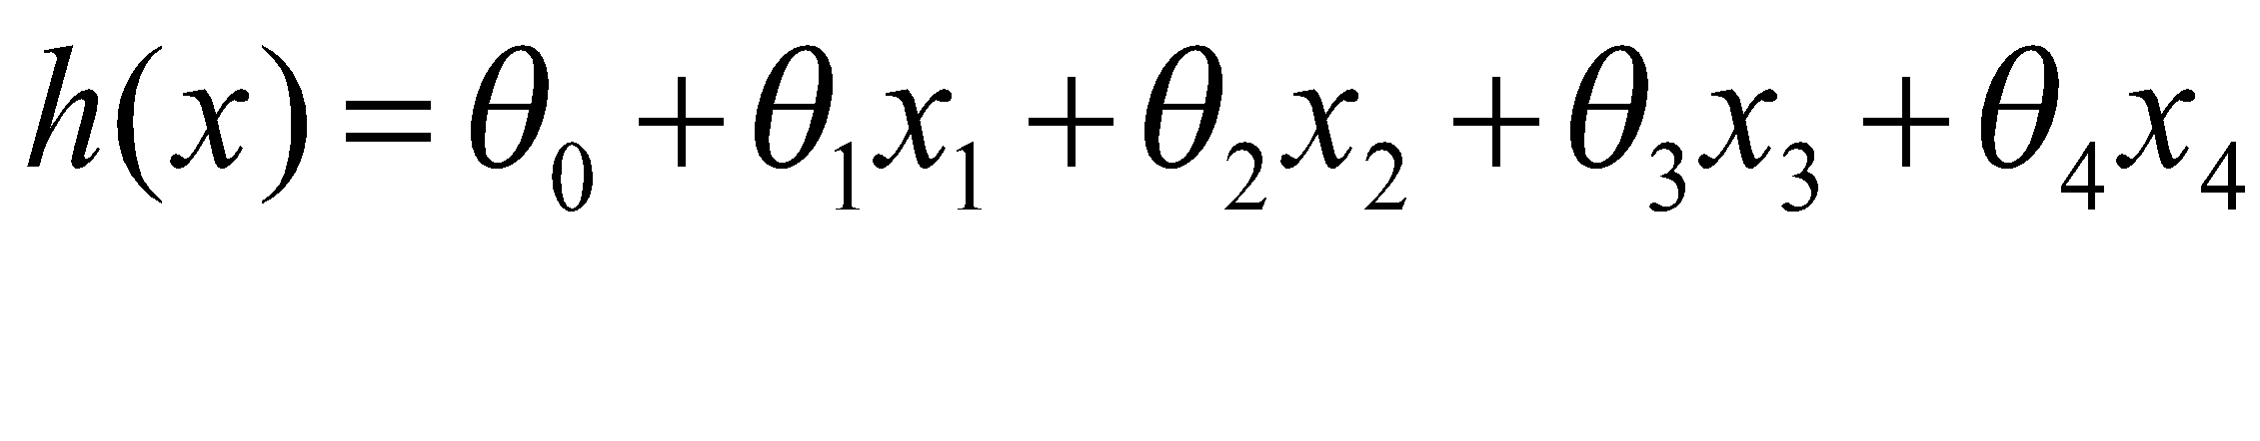
Size (feet²) X | Price ($1000) Y
2104 | 460
1416 | 232
1534 | 315
852 | 178
… | …
Linear Regression with 1 variable
Linear Regression with multiple variables
Size (feet²) x₁ | Number of bedrooms x₂ | Number of floors x₃ | Age of home x₄ | Price ($1000) x₅
2104 | 5 | 1 | 45 | 460
1416 | 3 | 2 | 40 | 232
1534 | 3 | 2 | 30 | 315
852 | 2 | 1 | 36 | 178
… | … | … | … | …

Slide 33
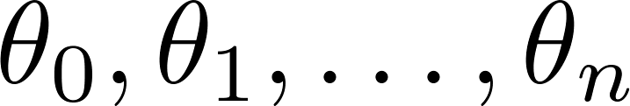
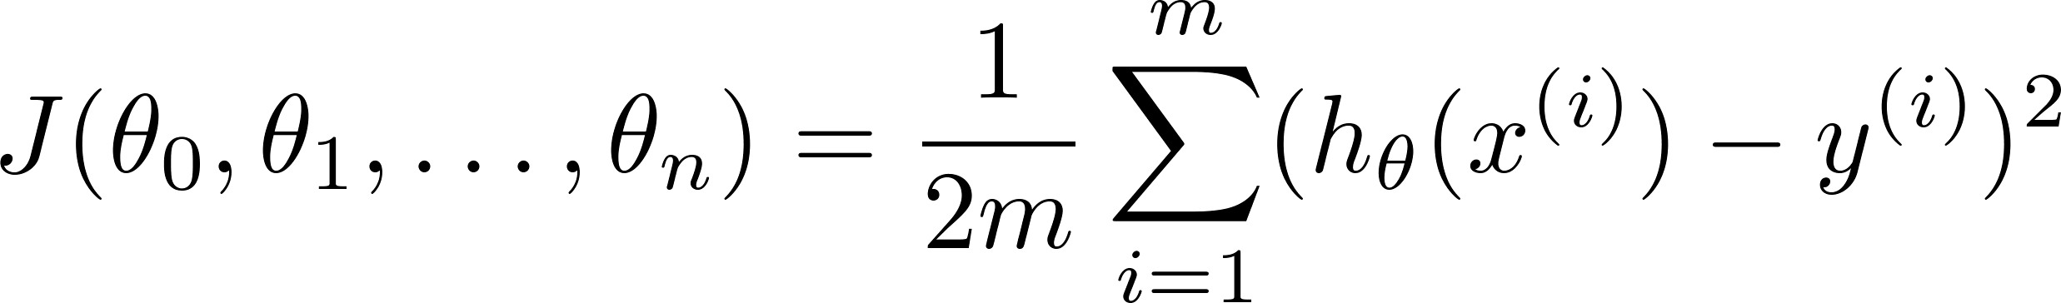

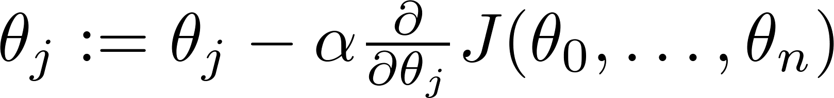

Hypothesis:
Parameters:
Cost function:
Gradient descent:
Repeat
(simultaneously update for every j = 0 , 1, … , n)

Slide 34

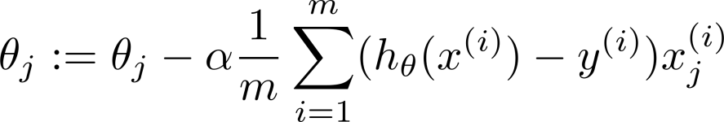
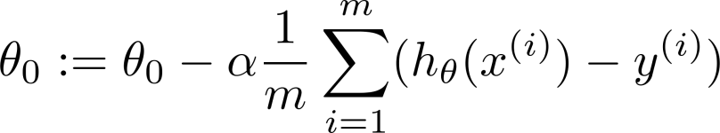



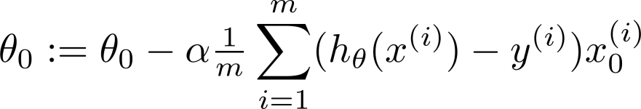
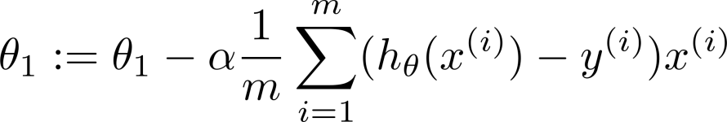
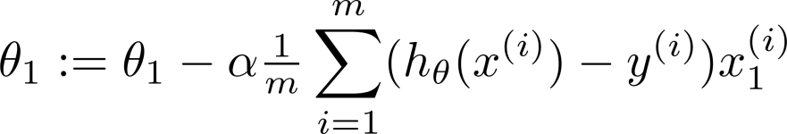

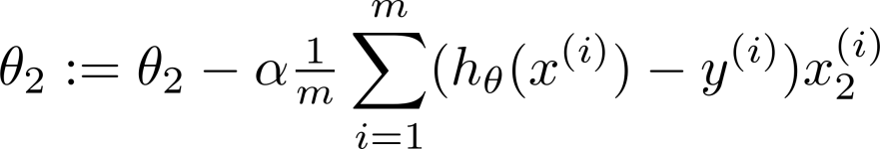
New algorithm :
Previously (n=1):
Repeat
Repeat
(simultaneously update for
)
(simultaneously update )

Slide 35
Gradient Descent
Its very important to perform feature scaling and mean normalization when performing gradient descent.

Slide 36
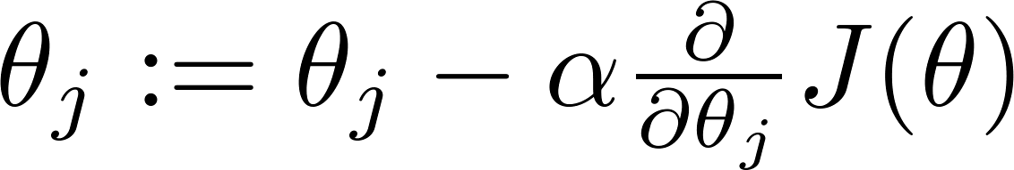
Gradient Descent Tinkering
Debugging – How to make sure gradient descent is working correctly.
How to choose learning rate α.

Slide 37

Making sure gradient descent is working
These examples are of where gradient descent not working.
Solution: Use smaller α
No. of iterations
For sufficiently small α , α should decrease on every iteration.
But if α is too small, gradient descent can be slow to converge.
No. of iterations

Slide 38
Summary
If α is too small: slow convergence
If α is too large, J(θ) may not decrease on every iteration; may not converge.
To choose α, try:
0.001, 0.003, 0.01, 0.03, 0.1, 0.3, 1, …
3x
3x

Slide 39
Outline
Regression
Linear regression
Classification
Logistic Regression

Slide 40
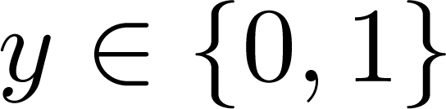
Classification
Email: Spam / Not Spam?
Online Transactions: Fraudulent (Yes / No)?
Tumor: Malignant / Benign ?
0: “Negative Class” (e.g., benign tumor)
1: “Positive Class” (e.g., malignant tumor)

Slide 41
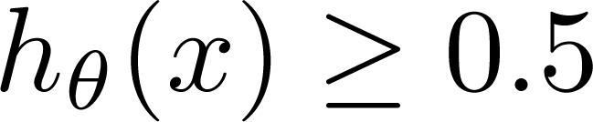
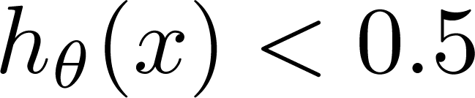
(Yes) 1
Malignant ?
(No) 0
Tumor Size
Tumor Size
Threshold classifier output at 0.5:
If , predict “y = 1”
If , predict “y = 0”

Slide 42
(Yes) 1
Malignant ?
(No) 0
Tumor Size
Tumor Size
Threshold classifier output at 0.5:
If , predict “y = 1”
If , predict “y = 0”

Slide 43
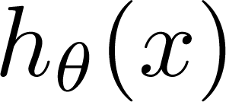

Classification: y = 0 or 1
can be > 1 or < 0
Hence, Linear regression is not the way to go…need another method for classification problems.
Logistic Regression:
Notes:
For classification, your result is either zero or one. However, if you use logistic regression your values can be greater than 1 or less than zero.

Slide 44


Logistic Regression
We will choose to define our function h as follows:
Called logistic function or sigmoid function
Notice that g(z) tends towards 1 as z → ∞, and g(z) tends towards 0 as z → −∞. Hence it is always bounded by 0 and 1.
Notes:
We want a classifier that outputs values between zero and 1
We will modify the hypothesis a g(𝑂^{T}x)
Where g is the logistic or sigmoid function
Fit the parameters

Slide 45
Logistic Regression
So, given the logistic regression model, how do we fit θ for it?
Let us define our classification model with a set of probabilistic assumptions, and then fit the parameters via maximum likelihood.
Let us assume that
Note that this can be written more compactly as

Slide 46


Logistic Regression Cost Function

Slide 47



Logistic Regression Cost Function
To fit parameters :
To make a prediction given new :
Output

Slide 48


Logistic Regression using Gradient Descent
Want :
Repeat
(simultaneously update all )
Algorithm looks identical to linear regression!

